Slide 1
mzalendo
info@mzalendo.com
rad@mzalendo.com

Slide 2
The price of apathy towards public affairs is to be ruled by evil men
Plato

Slide 3
Let’s be candid

Slide 4
Any resemblance to people, real or imagined is purely a coincidence

Slide 5
Let’s set the stage

Slide 6
The Status Quo

Slide 7
This Is A Politician

Slide 8
Big
Powerful
Decisive
All knowing
Omnipotent

Slide 9
This Is A Voter You

Slide 10
Small
Disinterested
Eat, sleep and work
No opinion
Beast of burden
Used and abused

Slide 11
Flashback

Slide 12
It began, as most great things do, in that engine of innovation, industry and achievement

Slide 13
A Bar

Slide 14
My good friend and eventual co-founder Ory Okolloh and I were having drinks reflecting on life as a whole and we (inevitably) got to discussing politics

Slide 15
Parliament website pulled down
No access to your representative
MP talk about ‘being disturbed’
Debate on the abilities of the MPs
Angst!

Slide 16
Epiphany
MP information is not a privilege
We have a right to know
Quality of leadership arguments takes place daily

Slide 17
The Reality
So we’ve argued.
Then what?

Slide 18
www.mzalendo.com

Slide 19
Mzalendo is a resource that attempts to do several things

Slide 20
Aspirant & MP Profiles
Names
Education
Work History
Contacts (Yes, contacts)
Leadership History (Terms served)
Commentary
Responsibilities (Ministers)

Slide 21
Administrative Information
Provinces
Districts
Constituencies
Polling Stations

Slide 22
Legislative Process
Questions
Motions
Bills
Hansard

Slide 23
Political Parties
Names
Symbols
Manifestos
Founding
Members

Slide 24
Resources
Audit reports
Standing Orders
CDF Reports

Slide 25
Ministries
Names
Brief responsibilities – Health vs. Public Health
Ministers/Assistants/PS
Past ministers/assistants

Slide 26
Challenges

Slide 27
Access
NOBODY wanted to give us information. Canvassing and pleading are skills we perfected

Slide 28
What Information?
Bills
Motions
Hansards
MP Attendance

Slide 29
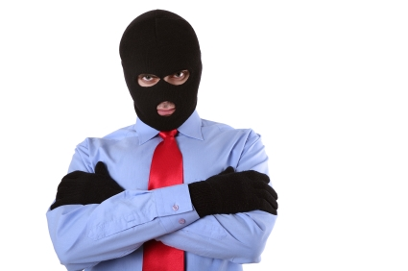
Security
We feared for our physical security.

Slide 30
Security?
Who is accessing the website & from where
Can somebody come after us?
It’s Our Turn To Eat

Slide 31
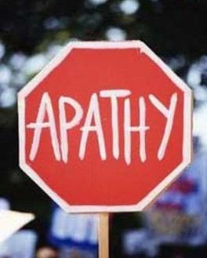
Entrenched Culture
Many Kenyans were apathetic towards government

Slide 32
Apathy?
Do we all vote?
Do we find there is a point?
What happens in government?
HOW does government work?

Slide 33
Blood, Sweat & Tears
No funding
No resources
Sacrifice personal time, nights and weekends

